Slide 1
Session Initiation Protocol
(SIP)
Aarti Gupta

Slide 2
Agenda
Why do we need SIP ?
The protocol
Instant Messaging using SIP
Internet Telephony with SIP
Additional applications
Future Directions

Slide 3
Introduction
SIP is the core protocol for initiating, managing and terminating sessions in the Internet
These sessions may be text, voice, video or a combination of these
SIP sessions involve one or more participants and can use unicast or multicast communication.

Slide 4
SIP entities
User Agent
User Agent Client
User Agent Server
Proxy Server
Redirect server
Registrar

Slide 5
SIP Message Types
Requests – sent from client to server
INVITE
ACK
BYE
CANCEL
OPTIONS
REGISTER
INFO

Slide 6
SIP Message Types (Contd.)
Responses – sent from server to the client
Success
Redirection
Forwarding
Request failure
Server failure
Global failure

Slide 7
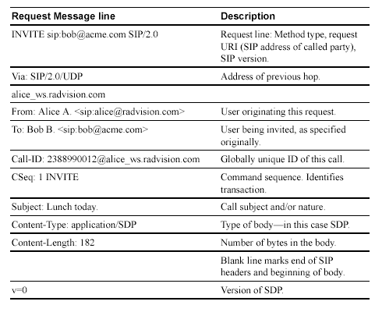
Courtesy – The RADVISION SIP Whitepaper

Slide 8


SIP Session Establishment and Call Termination
From the RADVISION whitepaper on SIP

Slide 9


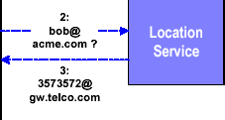




SIP Call Redirection
From the RADVISION whitepaper on SIP

Slide 10
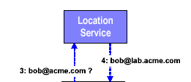






Call Proxying
From the RADVISION whitepaper on SIP

Slide 11
Instant messaging based on SIP
SIMPLE – IM protocol based on SIP
SIP promises interoperability between various IM vendors
“Forking proxy “
SIP has unique user tracking features.
SIP addressing

Slide 12

Instant Messaging (Contd.)
SIP Redirect server
columbia.edu
2
SIP proxy
5
Location
service
3
foo.com
6
dynamic.com
4
10
11
7
1
proxy
12
8
13
9
SIP Client
SIP Client
sales.foo.com

Slide 13
SIP for Internet Telephony
Two types of phones – IP phones and conventional analog phones.
Uses phone numbers instead of IP addresses
To place a call to an IP phone, DNS is used
To place a call to an analog phone, gateway
protocols like BGP are used

Slide 14
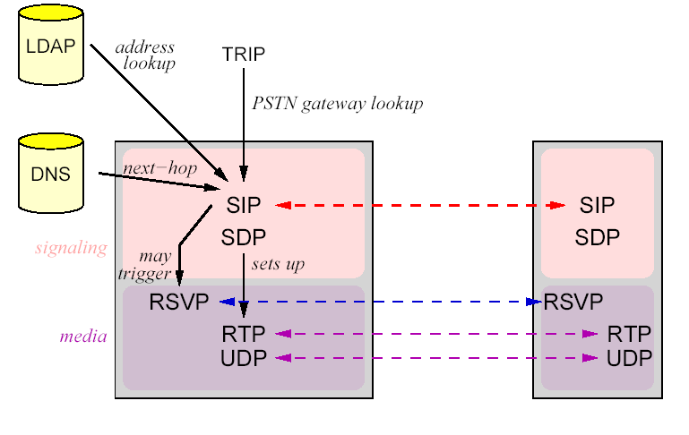
SIP Protocol Use
Henning Schulzrinne’s tutorial on SIP

Slide 15
Additional SIP applications
PINT (PSTN and Internetworking) protocol
Internet call waiting

Slide 16
What is the future of SIP
SIP is still a ‘proposed standard’
Competing protocol – H.323
IM vendors have not adopted SIP

Slide 17
References
Computer Telephony – June 2000
http://www.radvision.com
www.cs.columbia.edu/hgs/
www.networkcomputing.com
www.wikipedia.com

Slide 18
Thank you

